Slide 1
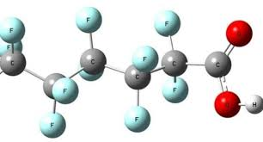
PFAS “Forever chemicals” in pesticides and on our farms and in our food.
Marguerite Adelman
Vermont PFAS Coalition, a project of the
Women’s International League for Peace and Freedom
pfasinfo@wilpfus.org

Slide 2
Pesticides & PFAS: Common Traits
Rachel Carson’s book Silent Spring, published in 1962, documented the environmental harm caused by the indiscriminate use of pesticides. Carson accused the chemical industry of spreading disinformation, and public officials of accepting the industry's marketing claims unquestioningly. Rachel Carson was right. Look at the similarities between PFAS and Pesticides.
Legacy pesticides and legacy per- and polyfluoroalkyl substances (PFOA and PFOS) are persistent in the environment. Once released, they take a very long time to degrade. PFAS take thousands of year.
Like PFAS, legacy pesticides have been found to bio-accumulate in the tissue of people and animals. They are harmful to health the living things.
Like PFAS, these chemicals move through water, soil, and air.
Like PFAS, soil testing for pesticides can be very expensive and the results are often difficult to understand.

Slide 3
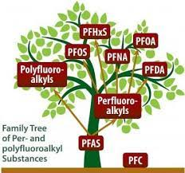
What are PFAS?
Per- and polyfluoroalkyl substances, also known as PFAS or “forever chemicals,” are a group of over 14,000+ man-made, toxic chemicals used in a variety of products.
PFAS are bio-accumulative (in all living beings) and travel through air, water, soil, and dust. They take thousands of year to degrade.
They are persistent, non-biodegradable, and toxic in minute quantities (one drop in 20 Olympic-size swimming pools).
Two types of PFAS -- PFOA and PFOS -- have been phased out of production in the US, but not out of our environment. However, these two types have been replaced by 14,000 other forms of PFAS that also cause severe threats to our health and environment.

Slide 4
Why should we be concerned about PFAS?
These chemicals may cause…
various forms of cancer : testicular, breast, kidney, liver, brain, etc.
thyroid disease
ulcerative colitis
high cholesterol
pregnancy-induced hypertension
weakened immune systems
reproductive health problems in both men and women
learning and developmental disabilities in infants and children (10% smaller penises in male babies; delayed menopause in female babies)
Studies have proven that PFAS have been present in the blood of most Americans and the breast milk of 100% of the women tested.
and men.

Slide 5
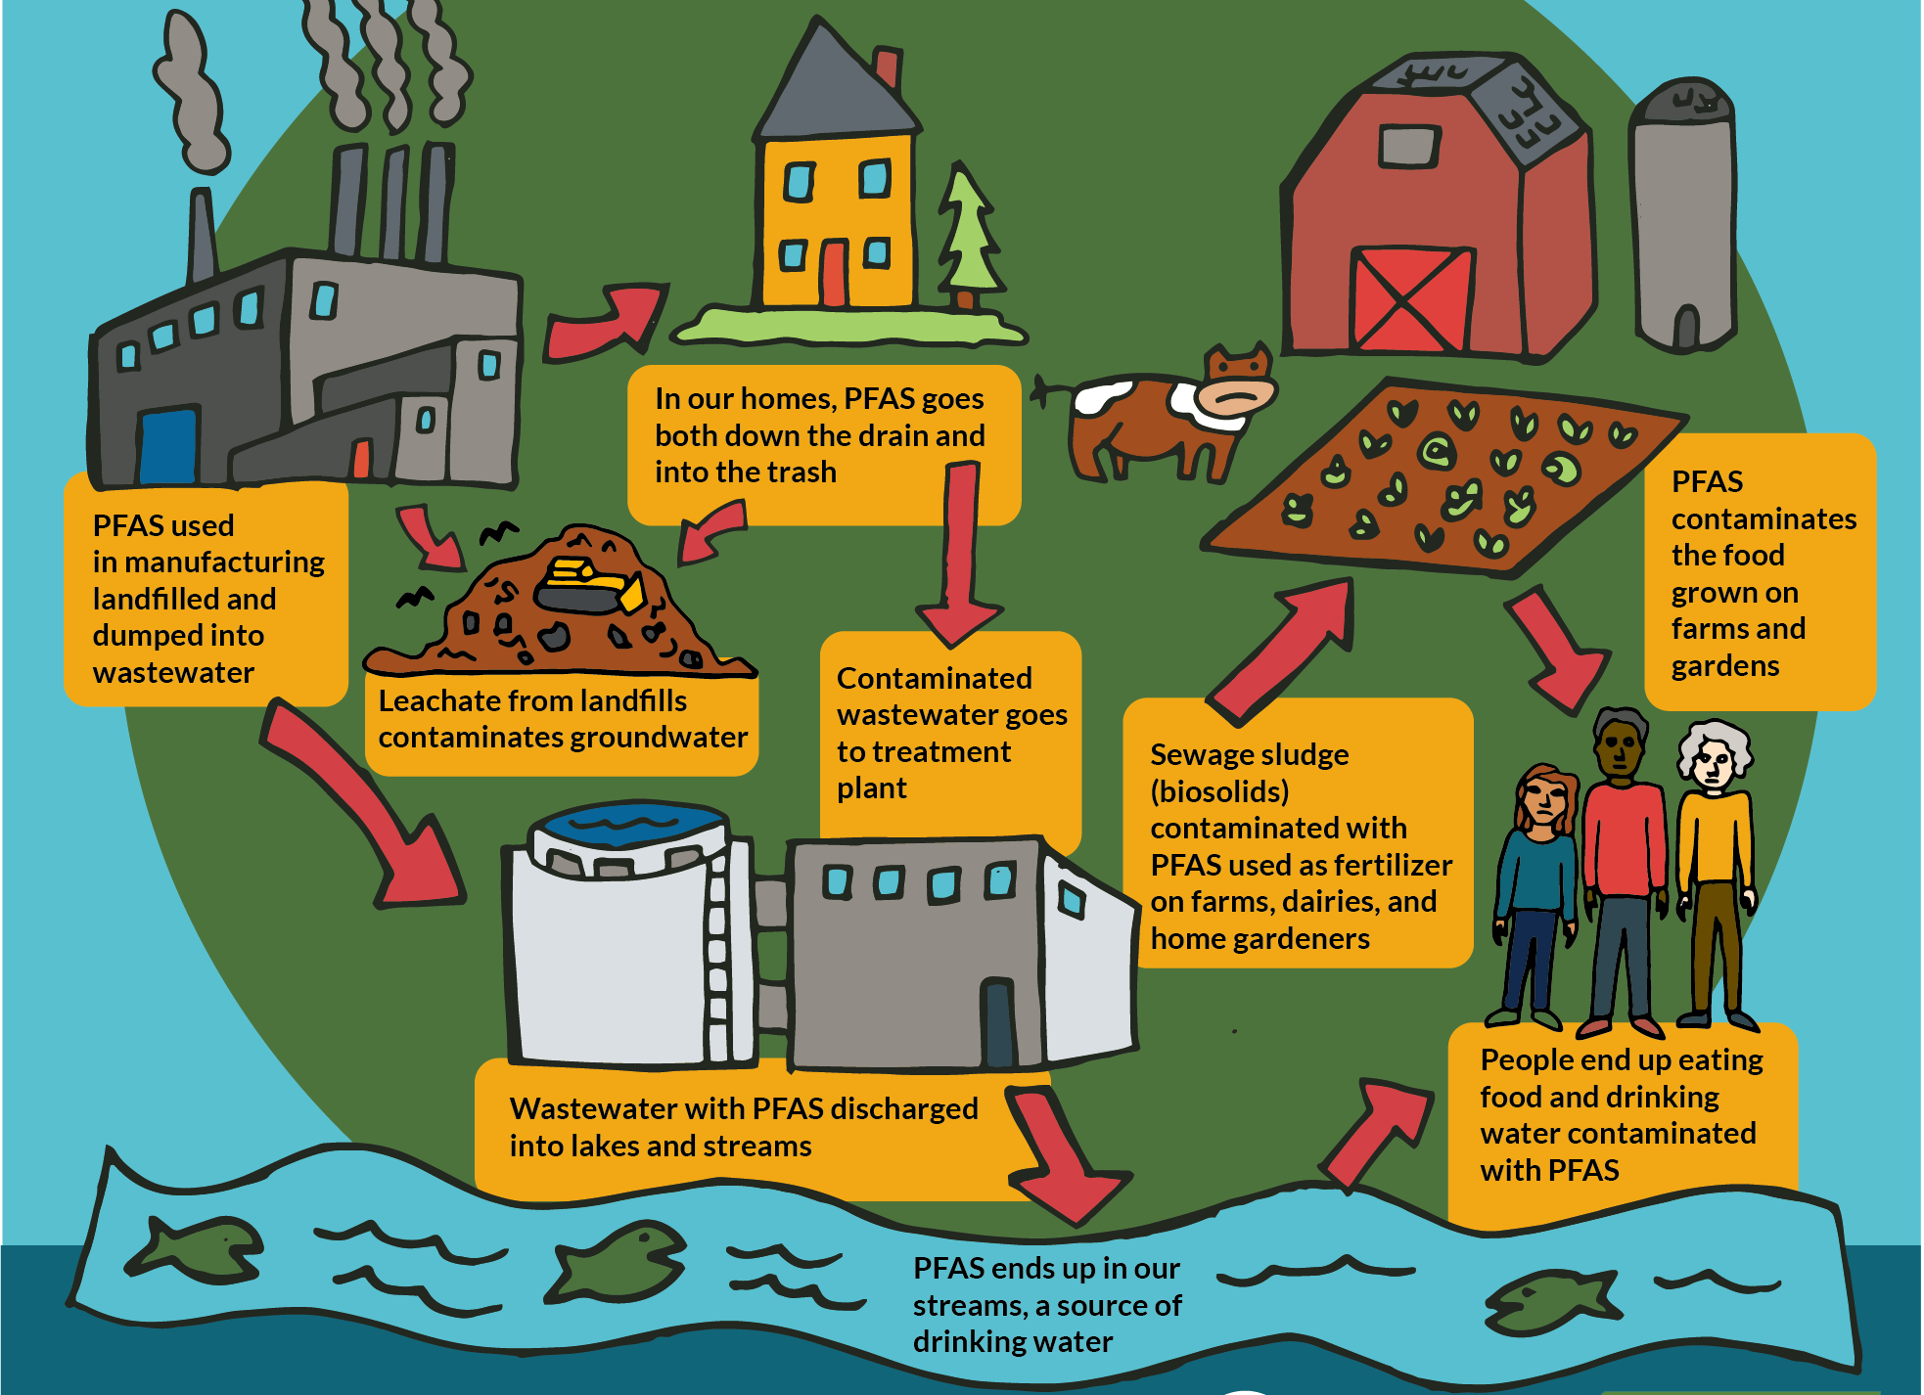
How does PFAS get in our food?
PFAS is ADDED to PESTICIDES which are used on our crops.

Slide 6
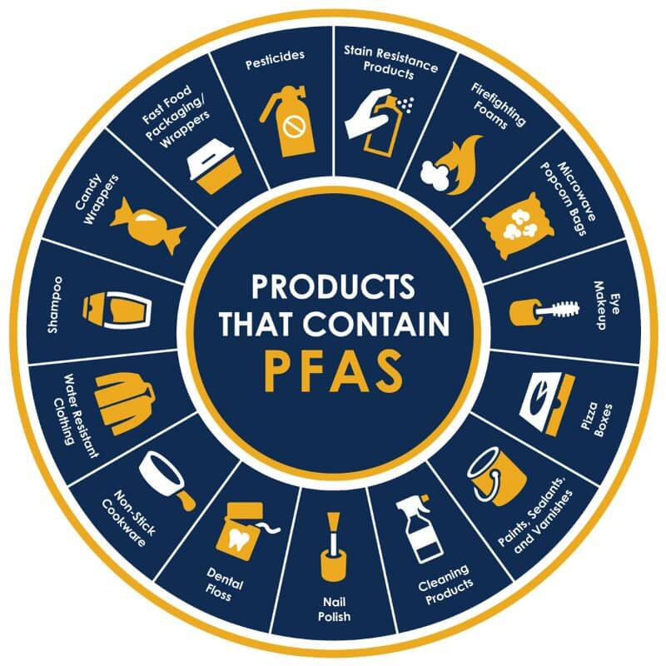
What products contain PFAS?
If you see the words “non-stick,” “water-resistant,” “stain-resistant,” “grease-resistant, or “long lasting,” you should check the product for PFAS.
Sunscreen: 67% contain harmful ingredients to children and adults
Cosmetics: 48% of cosmetics contain PFAS chemicals
Personal Care Products: contact lenses, dental floss, toilet paper, shampoos, conditioners, moisturizers, nail polish, female hygiene products, etc.
Food: Seafood, as well as some meats, dairy products, grains, produce, and fruits contain PFAS
Cleaning Products: Floor wax
Pesticides
Household and Consumer Products: rugs, paints, mattresses, clothing—school uniforms, outdoor clothing—rain and snow, shoes, ski wax, artificial turf, etc.
Cookware and Food Containers: especially fast-food wrappers, microwave popcorn, pizza boxes, etc.
Children’s Products: diapers, clothing, etc.
Water: tap, bottled, and well water
Fertilizers: biosludge, etc.
Drugs: a number of common medications include PFAS.

Slide 7
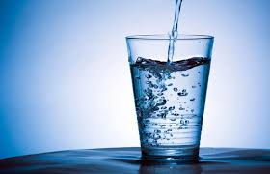
Does your drinking water contain PFAS?
Vermont's standard for the combination of five PFAS (PFOA, PFOS, PFHxS (perfluorohexane sulfonic acid), PFHpA [perfluoroheptanoic acid] and PFNA [perfluorononanoic acid]) is 20 ppt (parts per trillion). That means the sum of the five PFAS levels should not exceed 20 ppt in your drinking water.
The EPA has established a health advisory standard for PFAS (PFOA and PFOS) that is less than 1 ppt. The EPA has proposed new enforceable water standards for 6 forms of PFAS: 4 ppt of PFOA and PFOS and a health hazard index for 4 others.
Vermont wells are not tested for PFAS, nor do most water tests for wells test for these chemicals.
A number of bottled and carbonated waters contain PFAS.
Check out your public water source: https://anrweb.vt.gov/DEC/DWGWP/searchWS.aspx
A number of Killington drinking sources contain PFAS – ski wax?

Slide 8
PFAS & Pesticides: Double the Poison
55 PFAS-related chemicals have been found in over
1,400 pesticides.
None of the PFAS identified in these 1,400 pesticides are among the PFAS recently removed by the EPA from pesticides.
PFAS are used as active ingredients in pesticides because the fluorinated qualities of PFAS make the pesticide more effective and stable, as well as extend shelf life and provide an even coating. However, safer alternatives are available.
The use of fluorinated plastic containers has been found to cause PFAS contamination of some pesticides
Portuguese scientists (2022) found that from 2015-2020 almost 70% of the pesticides introduced by manufacturers used a formula made with fluorinated (PFAS) chemicals.

Slide 9
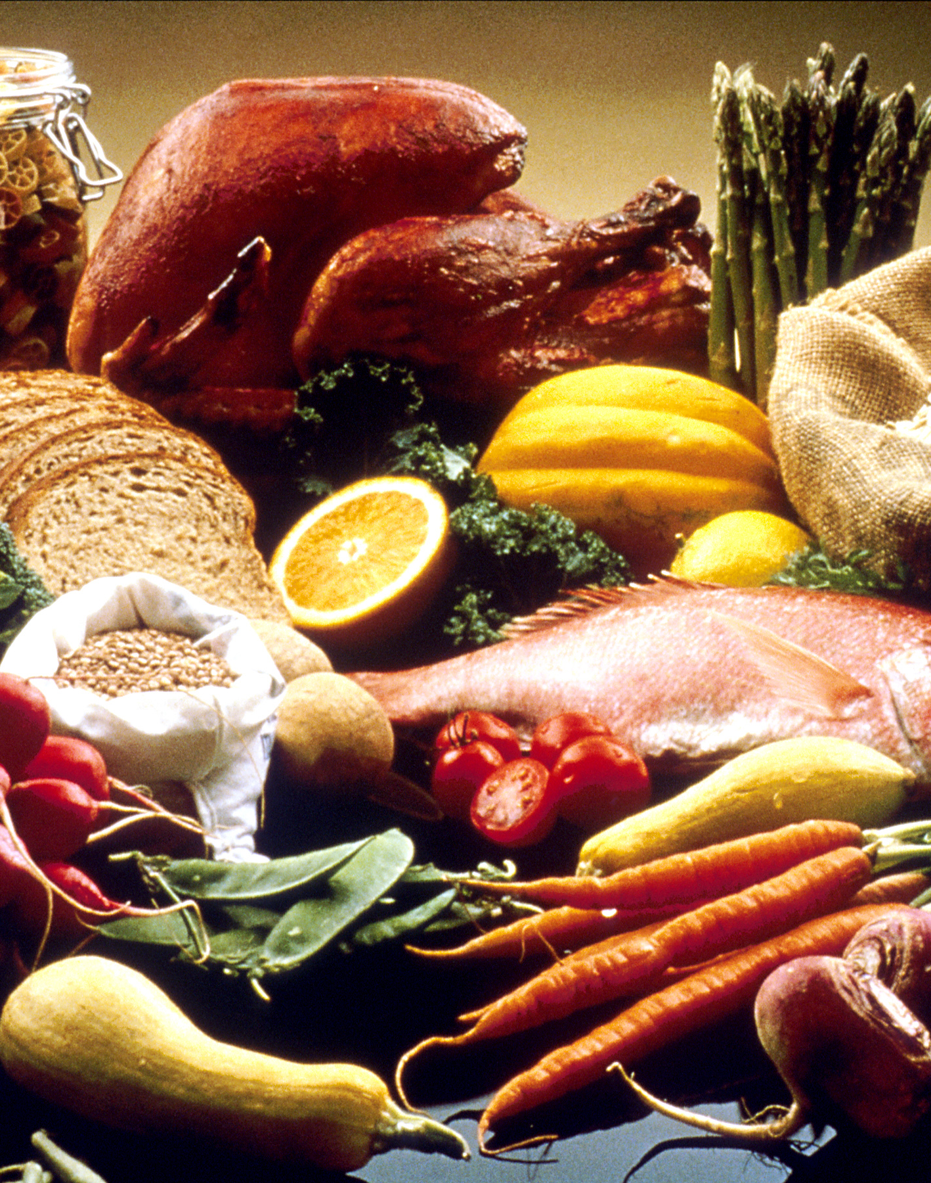
PFAS and/or Pesticides in our Food
A seafood survey, detected PFAS in 74% (60 out of 81) of samples of clams, cod, crab, pollock, salmon, shrimp, tilapia, and tuna. (2022 FDA study)
Eggs, certain kinds of meat (especially liver and other organ meats), honey, and dairy products have been found to have high levels of PFAS.
European Union scientists are documenting that fruits contain elevated levels of PFAS.
Grease-resistant packaging often contain oil-resistant PFAS. Beware fast food, pizza boxes, etc.
Strawberries, spinach, kale, collard and mustard greens, peaches, pears, nectarines, apples, grapes, bell and hot peppers, cherries, blueberries, and green beans all contain pesticides and/or PFAS.
PFAS have been detected in both bottled and tap water.

Slide 10
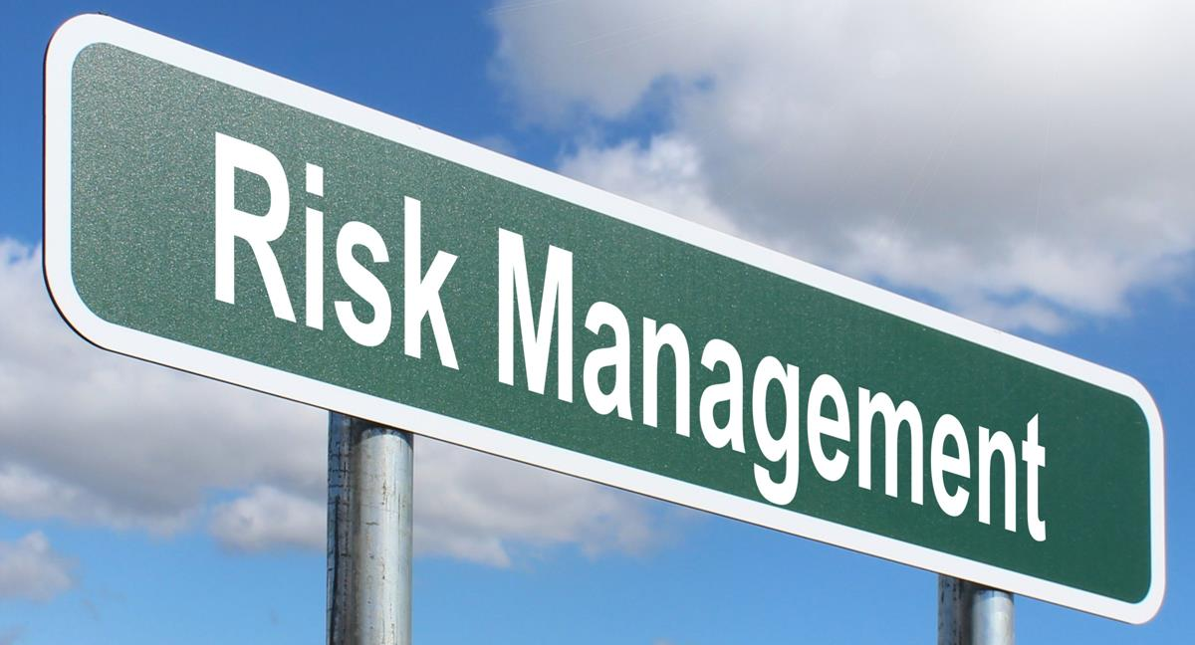
Take Action Against PFAS and Pesticides in our Food
Favor retailers that don’t use PFAS: https://pfascentral.org/pfas-free-products/
Don’t assume products with environmentally friendly claims are PFAS-free. Ask the retailer.
Purchase organic foods or grow your own without pesticides.
Transfer food out of packaging when you can.
Test your water for PFAS. If you use or serve bottled and carbonated waters, use brands with no PFAS: https://www.consumerreports.org/health/bottled-water/pfas-in-bottled-water-new-study-finds-a1111233122/
Help enact legislation to ban PFAS, especially in pesticides. Maine is the first state to enact a comprehensive ban on pesticides that include intentionally added PFAS, and pesticides contaminated with PFAS. Vermont should do this as well. Add PFAS in pesticides to S.25.
Help enact legislation to reduce the use of pesticides in Vermont. Make the Farm to Plate 20% reduction in pesticide use an enforceable and measurable piece of legislation. Why not take on the EU’s 50% goal of reduction by 2030?
Don’t use biosludge that hasn’t been tested for PFAS.
Use the EU’s Farmer’s Toolbox for Integrated Pest Management: https://datam.jrc.ec.europa.eu/datam/mashup/IPM/index.html
This Photo by Unknown Author is licensed under CC BY-SA

Slide 11
Resources You Can Use
www.militarypoisons.org
www.ewg.org
https://pfascentral.org
Farmer’s Toolbox for Integrated Pest Management: https://datam.jrc.ec.europa.eu/datam/mashup/IPM/index.html
A project of the Women’s International League for Peace and Freedom Earth Democracy Committee. For more information, contact Marguerite Adelman, WILPF Burlington Branch, at pfasinfo@wilpfus.org

