Slide 1
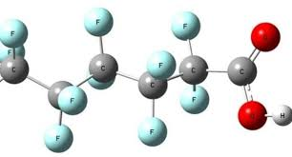
Per- and PolyFluroAlkly Substances(PFAS): Toxic Contamination without our Consent
Marguerite Adelman
WILPF US
Earth Democracy Committee
pfasinfo@wilpfus.org

Slide 2
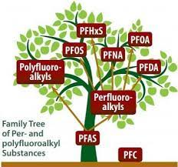
What are PFAS?
Per- and polyfluoroalkyl substances, also known as PFAS or “forever chemicals,” are a group of over 12,000+ man-made, toxic chemicals used in a variety of products.
PFAS are bio-accumulative and travel through air, water, soil, dust, and food.
Two types of PFAS -- PFOA and PFOS -- have been phased out of production in the US, but not out of our environment. However, these two types have been replaced by other forms of PFAS that also cause severe threats to our health and environment.

Slide 3
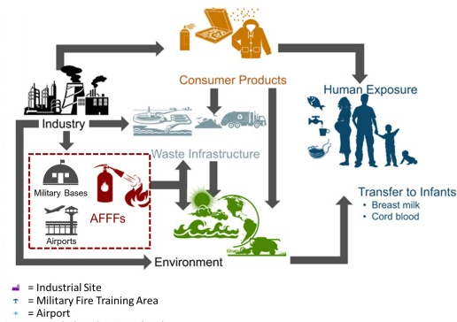
Where do PFAS come from?

Slide 4
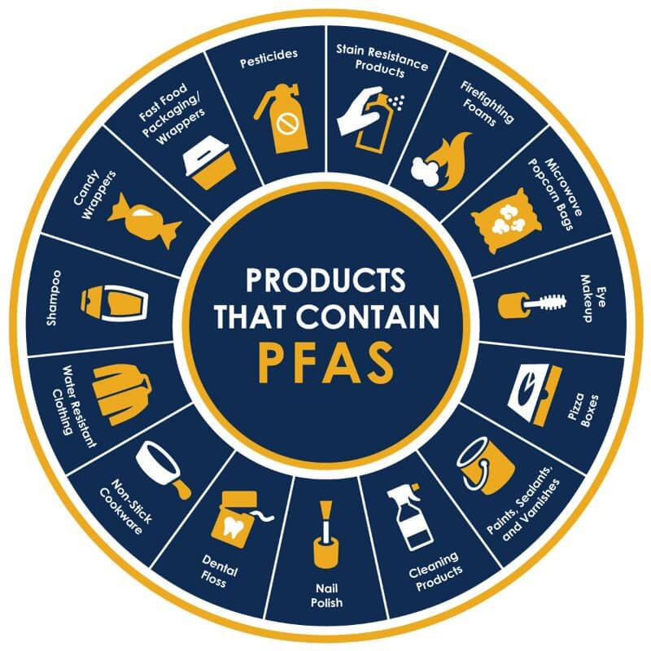
What products contain PFAS?
If you see the words “non-stick,” “water-resistant,” “stain-resistant,” “grease-resistant,: or “long lasting,” you should check the product for PFAS.
Sunscreen: 67% contain harmful ingredients to children and adults
Cosmetics: 48% of cosmetics contain PFAS chemicals
Personal Care Products: contact lenses, dental floss, toilet paper, shampoos, conditioners, moisturizers, nail polish, female hygiene products, etc.
Food: Seafood and some produce contain high amounts of PFAS
Cleaning Products: Floor wax
Bug Repellants and Pesticides
Household and Consumer Products: rugs, paints, mattresses, clothing—especially outdoor and sports clothing, shoes, ski wax, artificial grass/turf, etc.
Cookware and Food Containers
Children’s Products: diapers, clothing, etc.
Water: tap, bottled, and well water

Slide 5
Why should we be concerned about PFAS?
These chemicals may cause…
various forms of cancer
thyroid disease
ulcerative colitis
high cholesterol
pregnancy-induced hypertension
weakened immune systems
reproductive health problems in both men and women
learning and developmental disabilities in infants and children
obesity

Slide 6
What are gendered impacts of PFAS?
Impacts of PFAS on Women, Pregnant Women, and Children
PFAS has been shown to mimic estrogen, causing unexpected changes in how cells grow and develop.
PFAS is linked to lower birth weights, child developmental issues, pre-eclampsia, menstrual irregularities, and fertility issues.
PFAS cross the placenta, is detected in cord serum, and is transmitted to newborns and infants via contaminated breast milk.
PFAS may cause breast or cervical cancer
Impacts of PFAS on Men
PFAS can cause fertility issues in men.
PFAS can cause male babies to have smaller penises.
PFAS may cause men to develop testicular cancer.

Slide 7
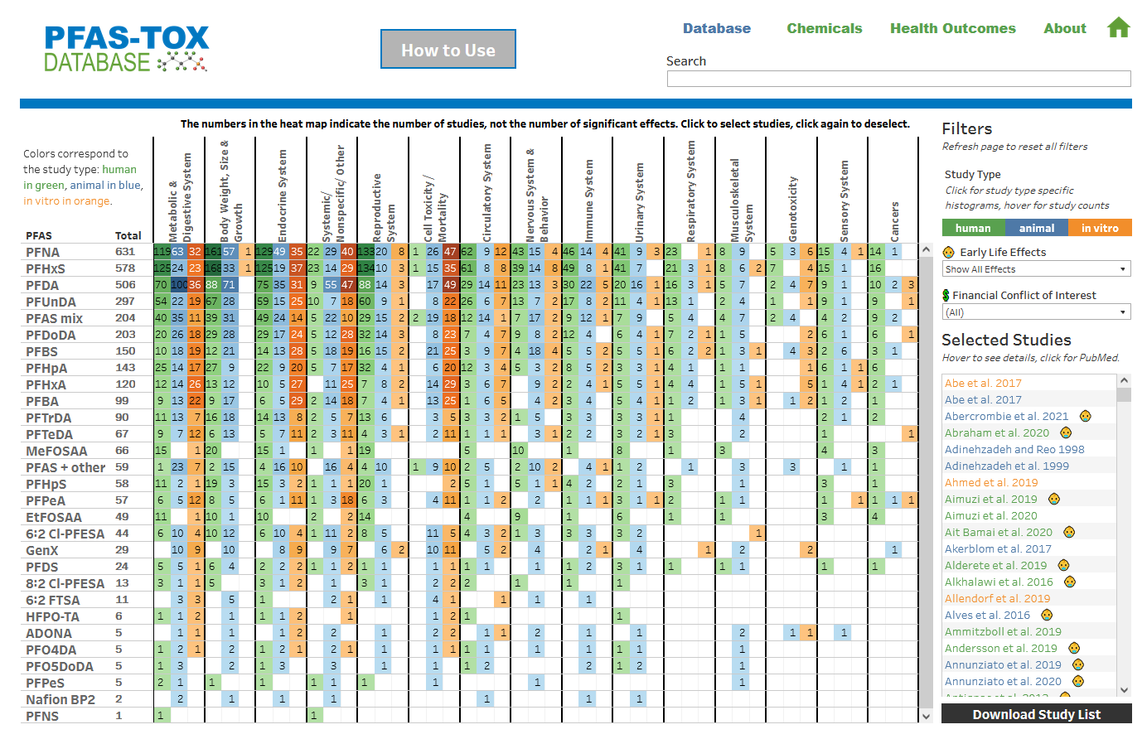
PFAS-TOX Database
https://pfastoxdatabase.org/

Slide 8
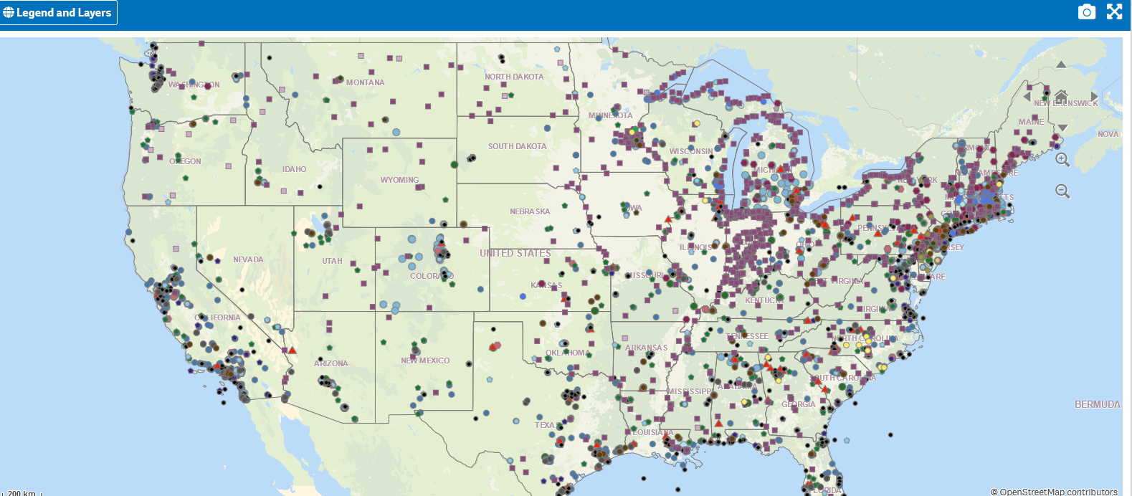
New EPA PFAS Analytic Tools
https://awsedap.epa.gov/public/extensions/PFAS_Tools/PFAS_Tools.html

Slide 9
PFAS Contamination in Europe
Le Monde:
Revealed: The Massive Contamination of Europe by PFAS Forever Chemicals

Slide 10
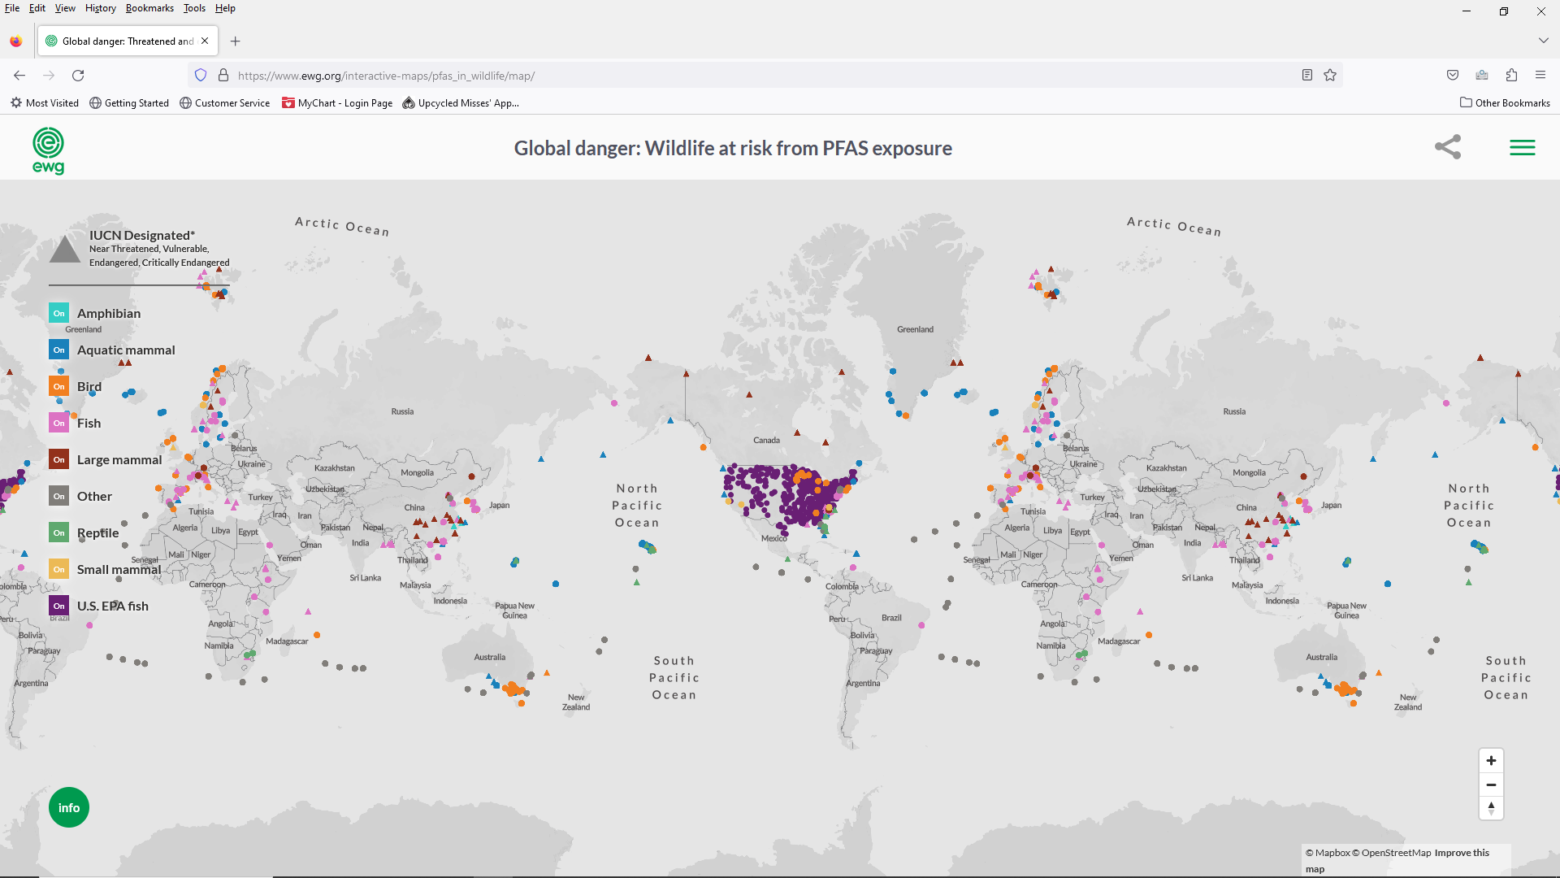
Global Danger: Wildlife at Risk from PFAS exposure
https://www.ewg.org/interactive-maps/pfas_in_wildlife/map/

Slide 11
PFAS Country Situation Reports………
THE GLOBAL PFAS PROBLEM:
https://ipen.org/documents/global-pfas-problem-fluorine-free-alternatives-solutions
Africa:
https://pfascentral.org/science/environmental-levels-and-human-body-burdens-of-per-and-poly-fluoroalkyl-substances-in-africa-a-critical-review
Australia:
https://pfas.australianmap.net/
CANADA: https://www.canada.ca/content/dam/eccc/documents/pdf/pded/pfas/draft-state-pfas-report.pdf CHINA:
https://enveurope.springeropen.com/articles/10.1186/s12302-020-00425-3
LATIN AMERICA: https://www.sciencedirect.com/science/article/pii/S0048969722048732
MIDDLE EAST & ASIA:
https://ipen.org/documents/pfas-pollution-across-middle-east-and-asia

Slide 12
PFAS
Regulatory
Timeline
PFAS Regulation Around the World:
https://int.anteagroup.com/news-and-media/blog/pfas-regulation-around-the-world
PFAS COUNTRY PORTAL:
https://www.oecd.org/chemicalsafety/portal-perfluorinated-chemicals/countryinformation/

Slide 13
New Water and Regulations on PFAS
EPA: The EPA established an interim health advisory of 0.004 parts per trillion (ppt) for PFOA and 0.02 ppt for PFOS. The EPA’s 2016 recommendation was 70 ppt for PFOA or PFOS individually or in combination. The EPA is now proposing to regulate PFOA and PFOS at a level that can be reliably measured, which is 4 parts per trillion (ppt). They have set a regulated health index on a combination of PFNA, PFHXs, PFBS, and GenX Chemicals.
ECHA: The European Chemicals Agency (ECHA) has recently published a proposal that is the most extensive and controversial to date. The proposal covers the manufacture and use of PFAS and has been developed over the past two years by Denmark, Germany, the Netherlands, Norway, and Sweden. The proposed restriction would cover around 10,000 PFAS substances based on their structural elements and is essentially a complete ban on all uses of PFAS.
WHO: The global health agency’s recent draft guidance recommends a limit of 100 ppt of either PFOA or PFOS in drinking water. It also recommends a total cap of 500 ppt for combinations of up to 30 PFAS.

Slide 14
PFAS and the United Nations Sustainable Development Goals
Goal 3: Ensure healthy lives and promote well-being for all at all ages.
Goal 6: Ensure availability and sustainable management of water and sanitation for all.
Goal 9: Build resilient infrastructure, promote inclusive and sustainable industrialization and foster innovation.
Goal 12: Ensure sustainable consumption and production patterns.
Goal 15: Protect, restore and promote sustainable use of terrestrial ecosystems, sustainably manage forests, combat desertification, and halt and reverse land degradation and halt biodiversity loss.
Goal 16: Promote peaceful and inclusive societies for sustainable development, provide access to justice for all and build effective, accountable and inclusive institutions at all levels.

Slide 15
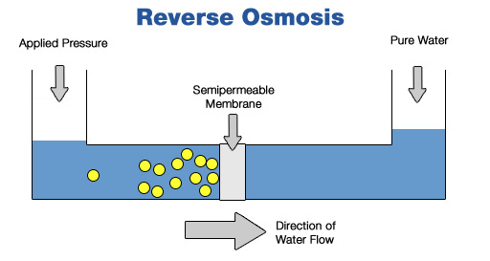
PFAS Remediation Systems
Certain technologies have been found to remove PFAS from drinking water, especially Perfluorooctanoic acid (PFOA) and Perfluorooctanesulfonic acid (PFOS).
Those technologies include:
activated carbon adsorption,
ion exchange resins,
and high-pressure membranes, such as nanofiltration or reverse osmosis.
These technologies can be used in drinking water treatment facilities, in water systems in hospitals or individual buildings, or even in homes at the point-of-entry, where water enters the home, or the point-of-use, such as in a kitchen sink or a shower.
https://www.epa.gov/sciencematters/reducing-pfas-drinking-water-treatment-technologies

Slide 16
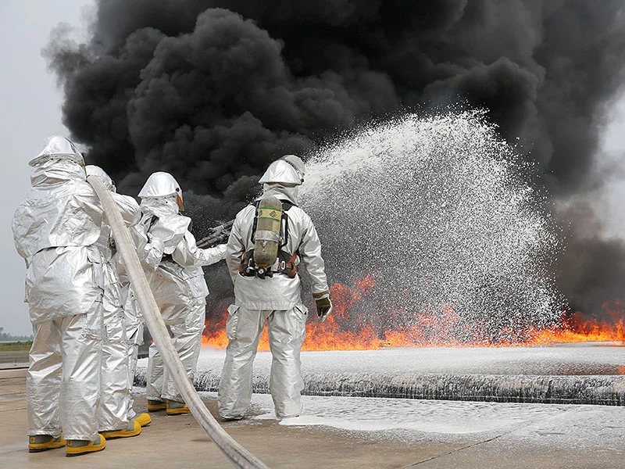
How is PFAS linked to the military?
The majority of Superfund sites are military bases and installations.
AFFF fire fighting foam is a major contributor to PFAS contamination.
Memorandums of Understanding (MOUs), Hold Harmless Agreements, and other legal contracts are being used in communities in the US and around the world to protect the military from lawsuits.
The military won’t commit to state and country cleanup standards.
The military is slow to acknowledge its culpability, evasive, and exceedingly slow at clean up.
The estimated cost to remediate and clean up PFAS contamination is 31 billion. The US military is requesting less for clean up than it did in the past.
Who is responsible for clean up in war zones and in other countries?

Slide 17
USA Massive Military Empire
https://worldbeyondwar.org/no-bases/?link_id=2&can_id=faa70dcaed644ab05d112e5a85502140&source=email-a-letter-from-the-chair-of-the-no-bases-campaign&email_referrer=email_1993484&email_subject=a-letter-from-the-chair-of-the-no-bases-campaign
LIST OF COUNTRIES WITH OVERSEAS MILITARY BASES: https://en.wikipedia.org/wiki/List_of_countries_with_overseas_military_bases

Slide 18
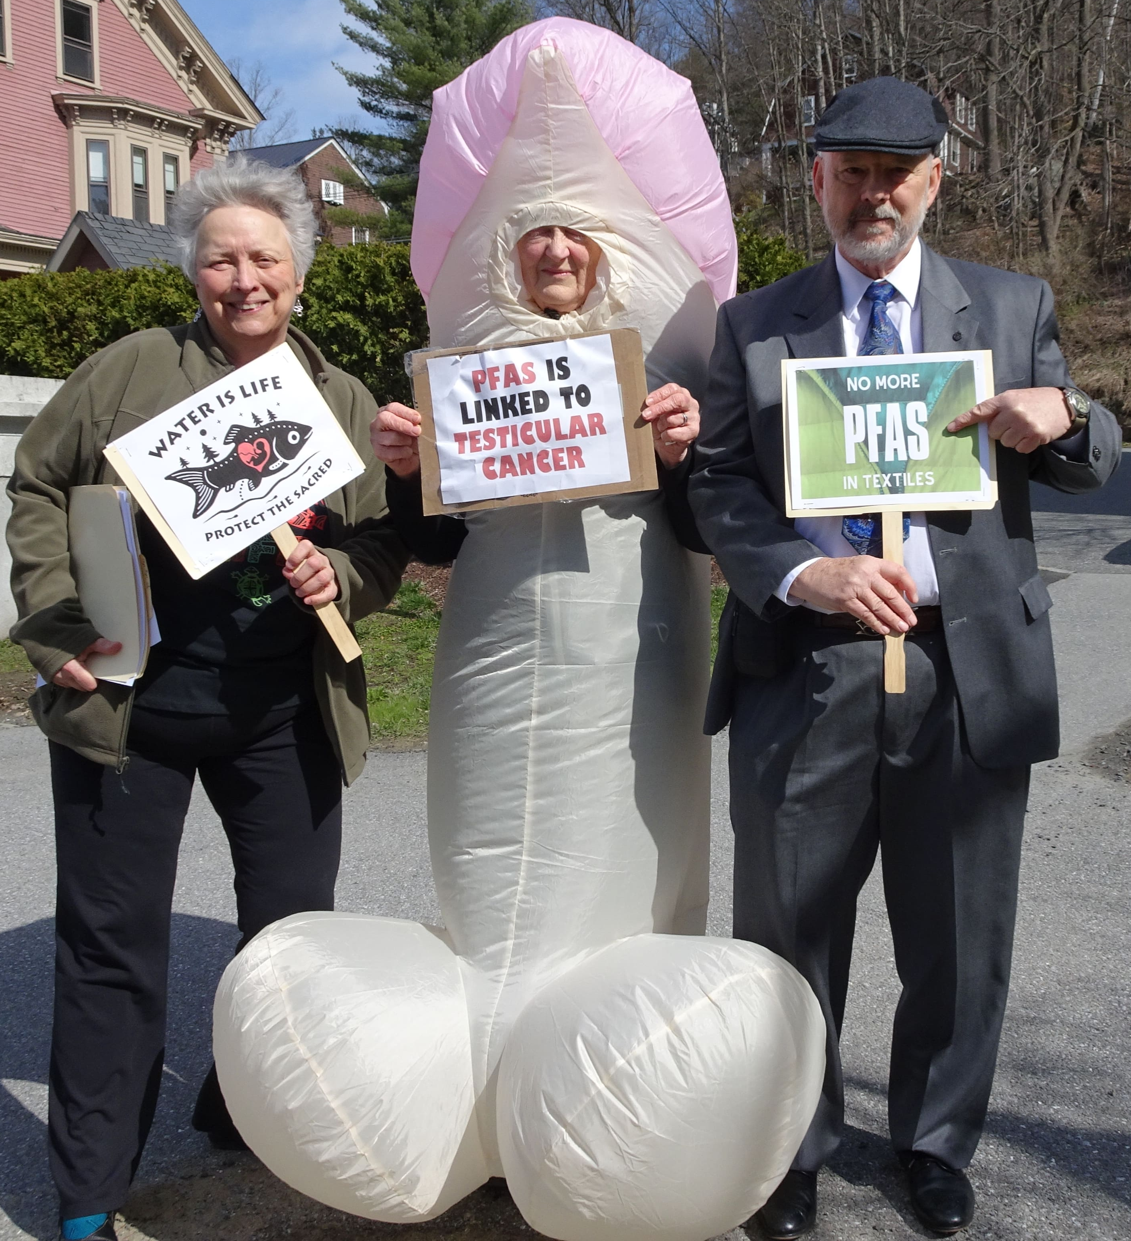
The VT PFAS/Military Poisons Coalition
Successes
Education
Public: information sheets, film festivals, farmers’ markets, etc.
Media: letters to the editor, radio shows, Facebook, website, community papers, etc.
Lawmakers: surveys, letters, meetings, testimony
Coalition building: landfill groups, pesticide groups, water groups, fishing groups, farming groups, peace groups, etc.
Challenges
Sustaining interest over time
Passing legislation
Funding for staff

Slide 19
How can I reduce my PFAS risk?
Avoid water, grease and stain-resistant products: water-proof clothing,
stain-resistant carpet, and grease-proof food packaging.
Replace non-stick cookware with safer alternatives, such as cast iron
and stainless steel.
Ask your government or water provider to test for PFAS. If they have
been found, demand installation of treatments that remove them, or provision of alternative
water sources.
Buy PFAS-free products: furniture, fabric covers, carpet, clothing, and food packaging. Use these websites to help you.
PFAS Central: https://pfascentral.org/pfas-free-products/
EWG: https://www.ewg.org/withoutintentionallyaddedpfaspfc and also EWG’s guides for cleaning supplies, etc.
Silent Spring smartphone app: https://silentspring.org/detox-me-app-tips-healthier-living
Green Screen: https://www.greenscreenchemicals.org/certified/products
Guidance on limiting PFAS exposure from the PFAS Exchange: https://pfas-exchange.org/resources/how-to-reduce-your-exposure-to-pfas/
This Photo by Unknown Author is licensed under CC BY-SA

Slide 20
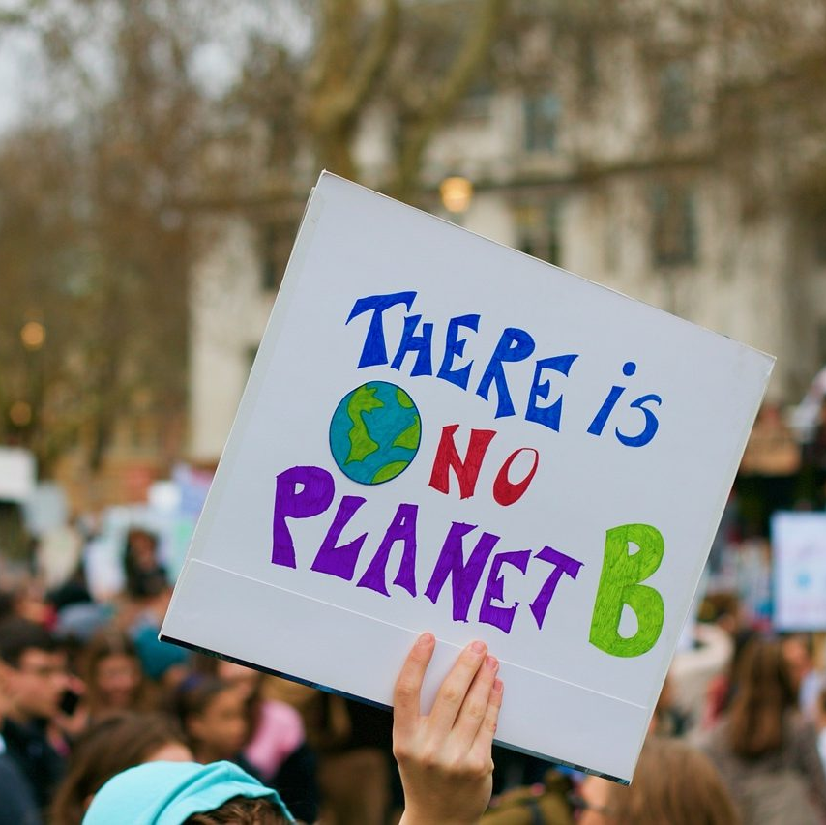
What actions can I take on PFAS?
Educate yourself about PFAS.
Set up a Goggle Alert for PFAS.
Limit your use and purchase of products that have PFAS.
Write to manufacturers who use PFAS in their products.
Ask your city, hospital, school to stop buying products with PFAS.
Advocate for legislation to ban PFAS at the local level.
Advocate for legislation to ban PFAS at the national level.
This Photo by Unknown Author is licensed under CC BY-ND

Slide 21
Resources
www.militarypoisons.org
www.ewg.org
https://pfasproject.com
www.civilianexposure.org
https://pfascentral.org
https://chemsec.org
https://www.edc-free-europe.org/
https://ipen.org
https://echa.europa.eu
https://www.who.int/health-topics/water-sanitation-and-hygiene-wash#tab=tab_1
https://www.oecd.org/chemicalsafety/portal-perfluorinated-chemicals/countryinformation/
A project of the Women’s International League for Peace and Freedom Earth Democracy Committee. For more information, contact Marguerite Adelman, WILPF Burlington Branch, at pfasinfo@wilpfus.org

